Slide 1

Numerical Integration
Trapezoidal and Simpson Rule
Romberg Formula
prepared by Razana Alwee
Notes:
prepared by Razana Alwee

Slide 2
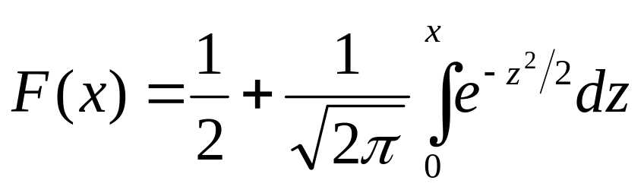
Numerical Integration
Many definite integrals of interest can’t be evaluated analytically.
Probably the best-known example is the integral that gives the area under the standard bell-shaped curve, given by
This integral appears very frequently in probability and statistics and is extensively tabulated.
prepared by Razana Alwee

Slide 3
Numerical Integration
The integral is tabulated because it is a fact that there is no way to express the antiderivative of exp(-z²) in terms of elementary functions.
Because of cases like this we need methods to perform approximate integration; for other cases it may be more convenient to use a numerical method than a symbolic one.
Often we’re given values of f(x) at various points but not a formula for f and so have no choice but to use a numerical method (for example, data from an experiment)
prepared by Razana Alwee

Slide 4

Numerical Integration
The Newton-Cotes formula
  Trapezoidal Rule
  Simpson’s Rule
Romberg Integration
Gaussian Quadrature
prepared by Razana Alwee

Slide 5
Trapezoidal Rule
The trapezoidal rule is equivalent to approximating the area of the trapezoid under the straight line connecting f(a) and f(b).
f(b)
f(a)
a
b
prepared by Razana Alwee

Slide 6
Trapezoidal Rule
One way to improve the accuracy of the trapezoid rule is to divide the integration interval from a to b into a number of segments (N).
The areas of individual segment can then be added to yield the integral for the entire interval.
There are N+1 equally spaced nodes
x₀, x₁, …., x_{N}
prepared by Razana Alwee

Slide 7
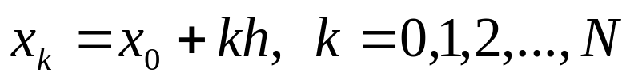
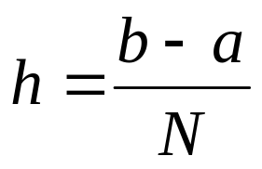
Trapezoidal Rule
Let, x₀=a and x_{N}=b
Assume
are equally spaced nodes
prepared by Razana Alwee

Slide 8
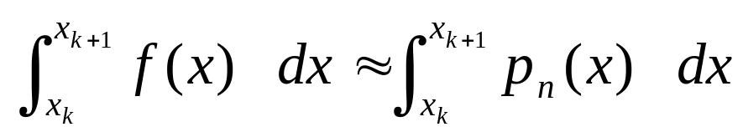
Trapezoidal Rule
Therefore
with
prepared by Razana Alwee

Slide 9
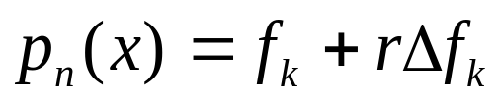
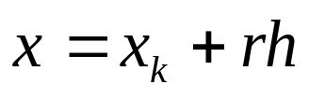

Trapezoidal Rule
Let
with
prepared by Razana Alwee

Slide 10
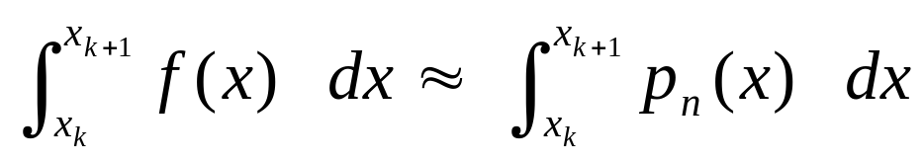
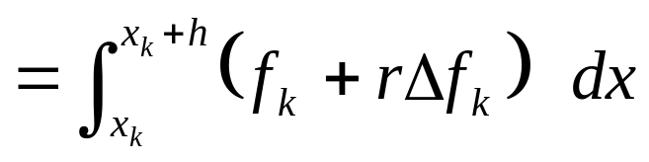
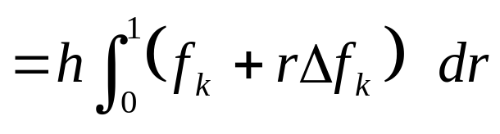
Trapezoidal Rule
prepared by Razana Alwee

Slide 11
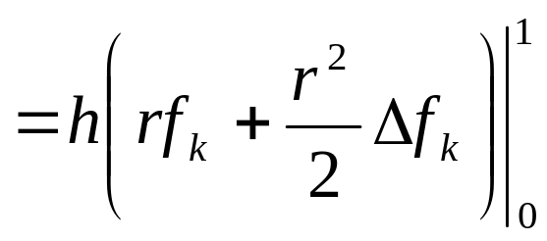
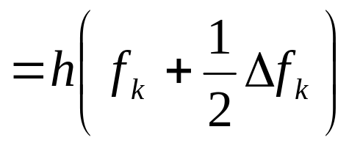
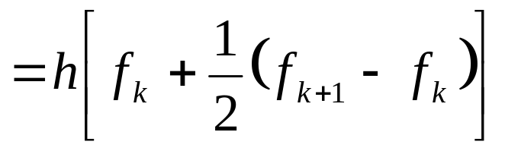
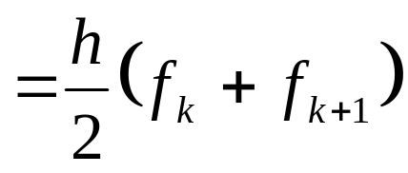
Trapezoidal Rule
prepared by Razana Alwee

Slide 12
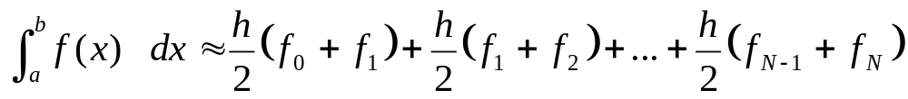
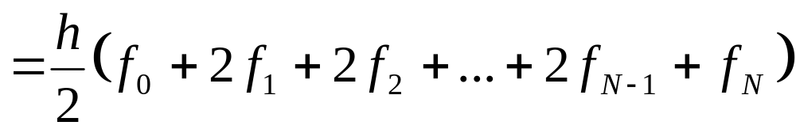
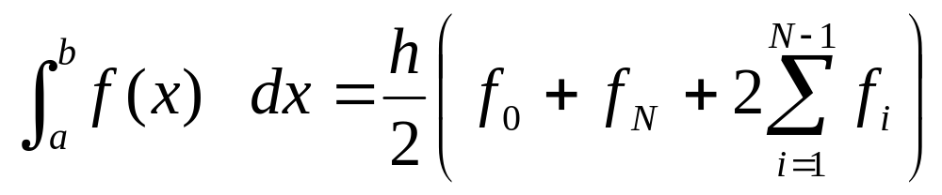
Trapezoidal Rule
prepared by Razana Alwee

Slide 13
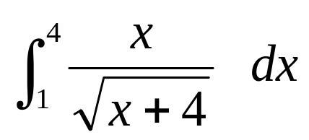
Example
Approximate the following integral using the Trapezoidal rule with h=0.5 and h=0.25.
prepared by Razana Alwee

Slide 14
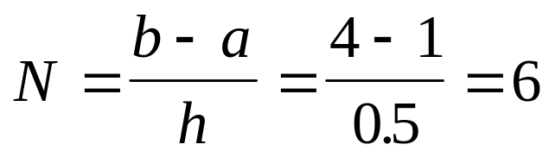
Example
For h=0.5, a=1 and b=4
prepared by Razana Alwee

Slide 15
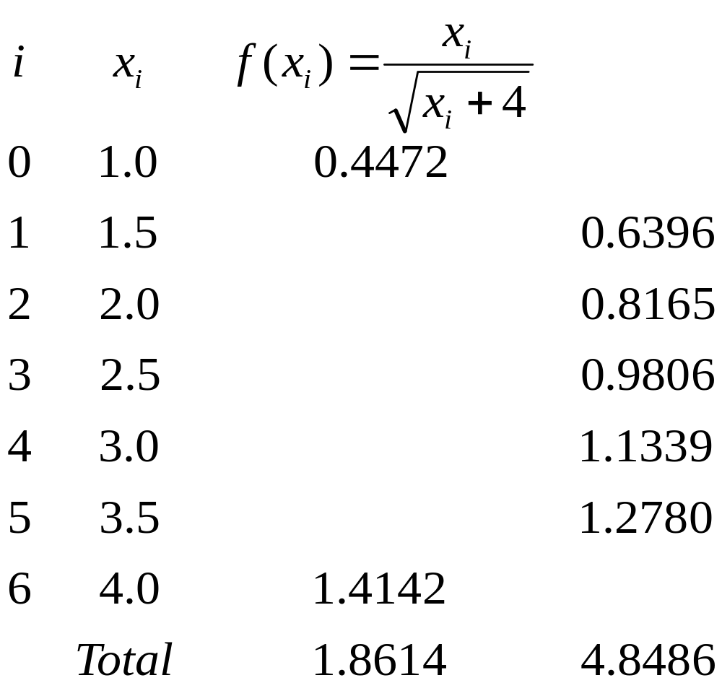
Example
prepared by Razana Alwee

Slide 16
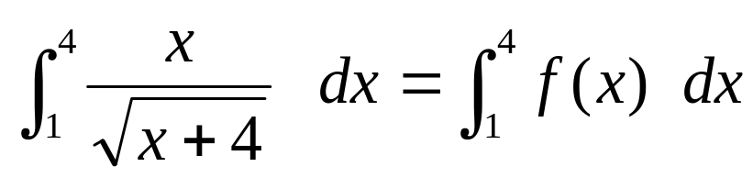
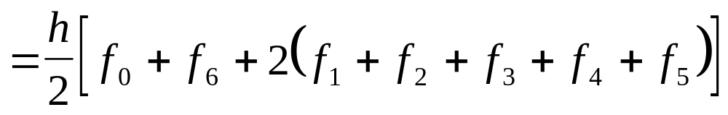
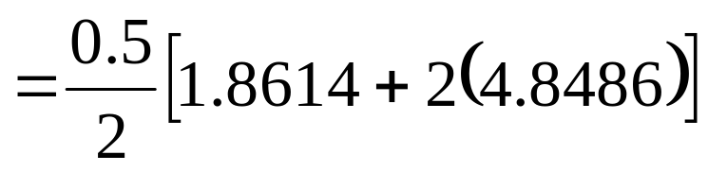

Example
prepared by Razana Alwee

Slide 17
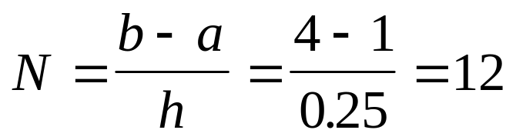
Example
For h=0.25, a=1 and b=4
prepared by Razana Alwee

Slide 18
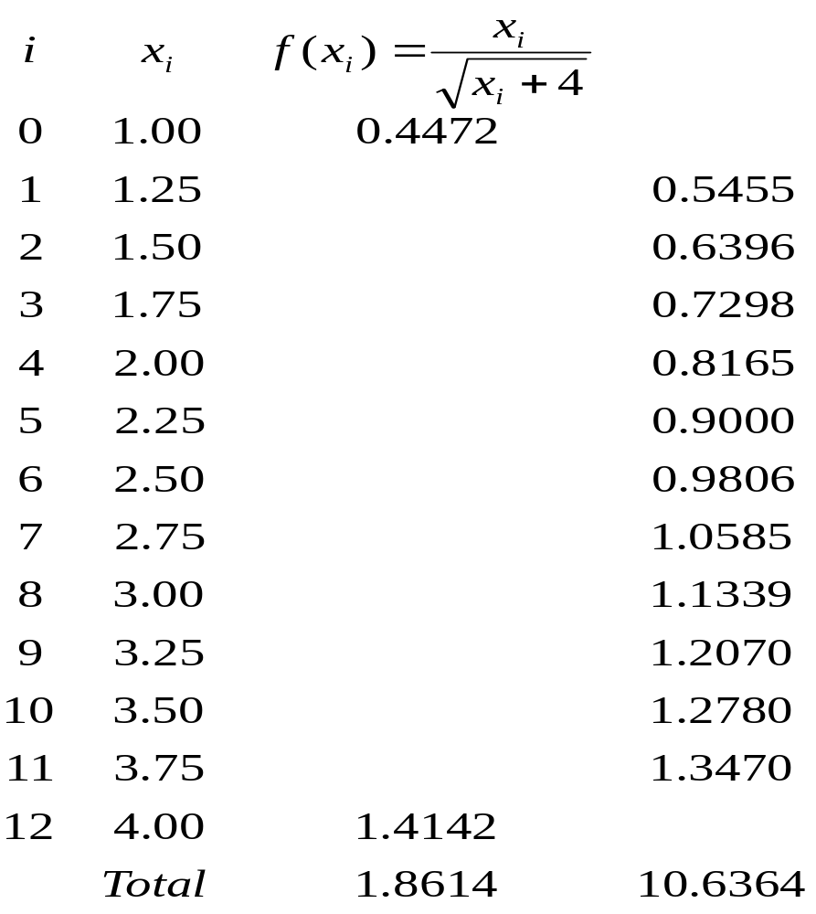
Example
prepared by Razana Alwee

Slide 19
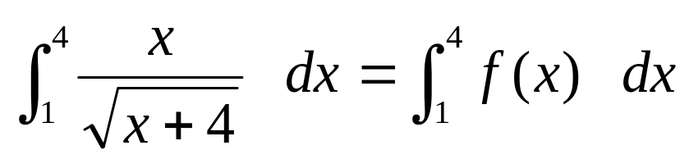
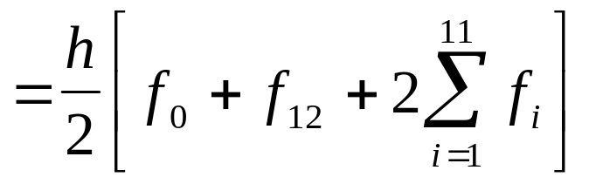
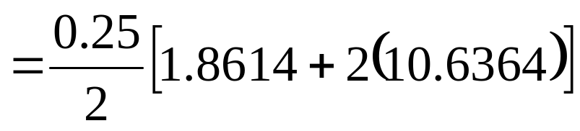

Example
(Note: The exact value of the integral is 2.8925)
prepared by Razana Alwee

Slide 20
Example
For h=0.5, N=6, the error is 0.0029
For h=0.25, N=12, the error is 0.0007
The error decreases as the number of segments (N) increases.
When h is reduced by a factor of ½ the successive errors are diminished by approximately ¼.
prepared by Razana Alwee

Slide 21
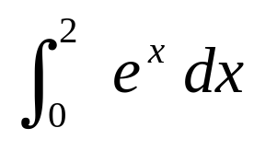
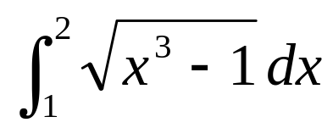
Exercise
Approximate the following integrals using the Trapezoidal rule with N=10.
(a) (b)
prepared by Razana Alwee

Slide 22
Simpson’s Rule
The trapezoidal rule usually requires a large number of function evaluations to achieve an accurate answer.
Another way to obtain a more accurate estimate of an integral is to use higher-order polynomials to connect the points.
prepared by Razana Alwee

Slide 23
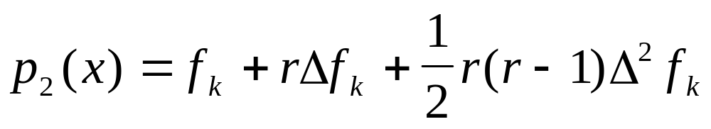
Simpson’s Rule
Let
prepared by Razana Alwee

Slide 24
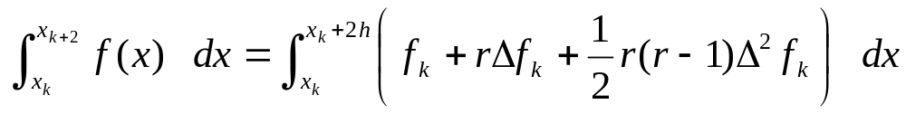
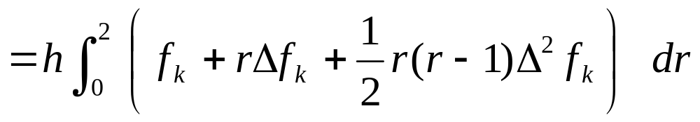
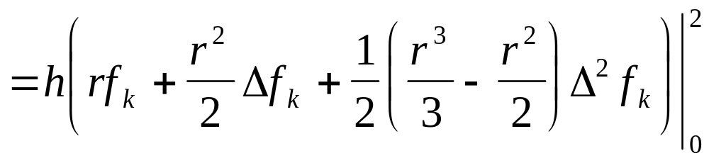
Simpson’s Rule
prepared by Razana Alwee

Slide 25
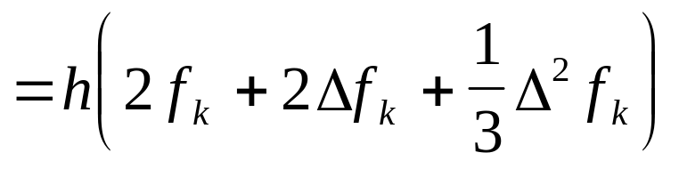
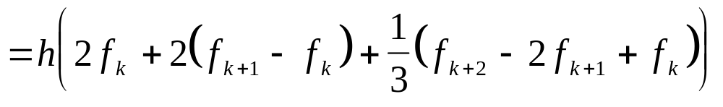
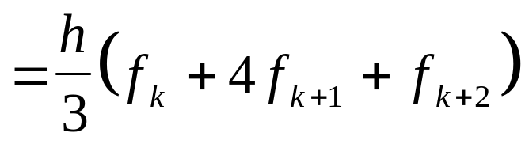
Simpson’s Rule
prepared by Razana Alwee

Slide 26
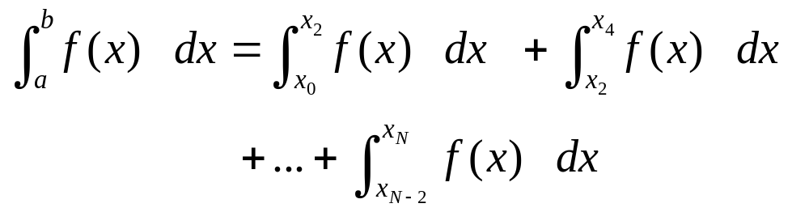
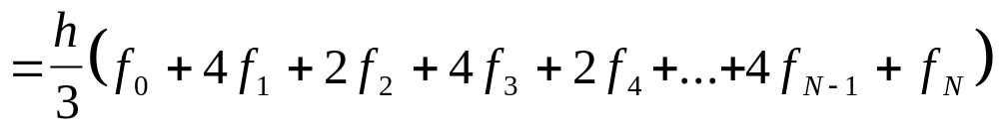
Simpson’s Rule
Subdivide the interval [a,b] into N subintervals (N is even).
prepared by Razana Alwee

Slide 27
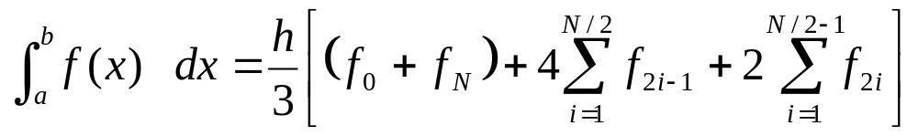
Simpson’s Rule
This equation is known as Simpson’s 1/3 rule.
Where N is even.
prepared by Razana Alwee

Slide 28
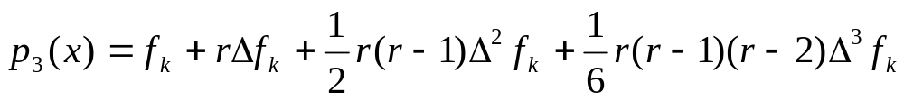
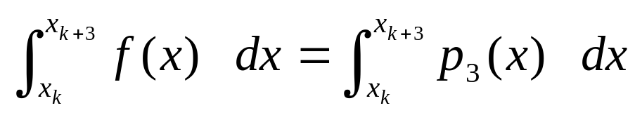
Simpson’s 3/8 Rule
Let,
prepared by Razana Alwee

Slide 29
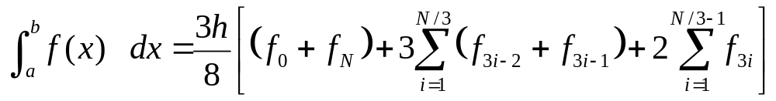
Simpson’s 3/8 Rule
where N= 3, 6, 9, 12, ..…
This equation is called Simpson’s 3/8 rule because h is multiplied by 3/8.
prepared by Razana Alwee

Slide 30

Example
Approximate the following integrals using the Simpson’s 1/3 rule with h=0.5 and h=0.25.
prepared by Razana Alwee

Slide 31
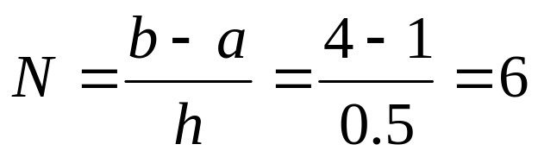
Example
For h=0.5, a=1 and b=4
(N is even)
prepared by Razana Alwee

Slide 32
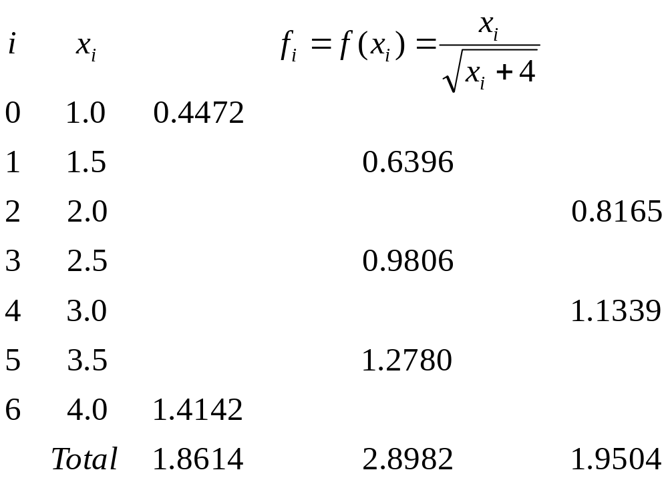
Example
prepared by Razana Alwee

Slide 33
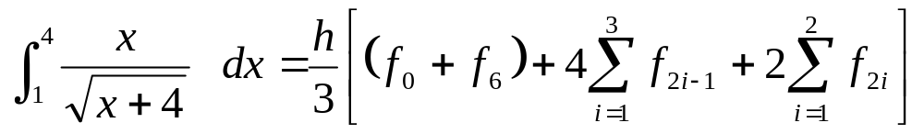
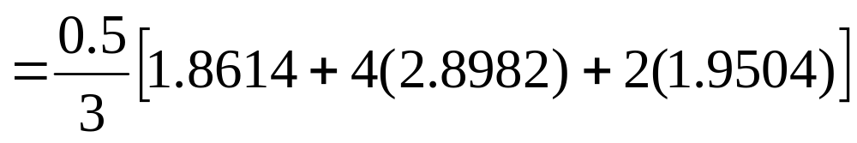

Example
prepared by Razana Alwee

Slide 34
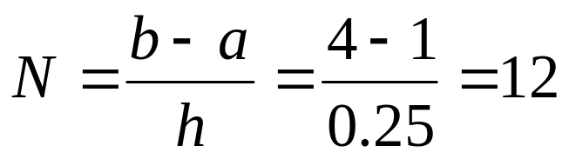
Example
For h=0.25, a=1 and b=4
(N is even)
prepared by Razana Alwee

Slide 35
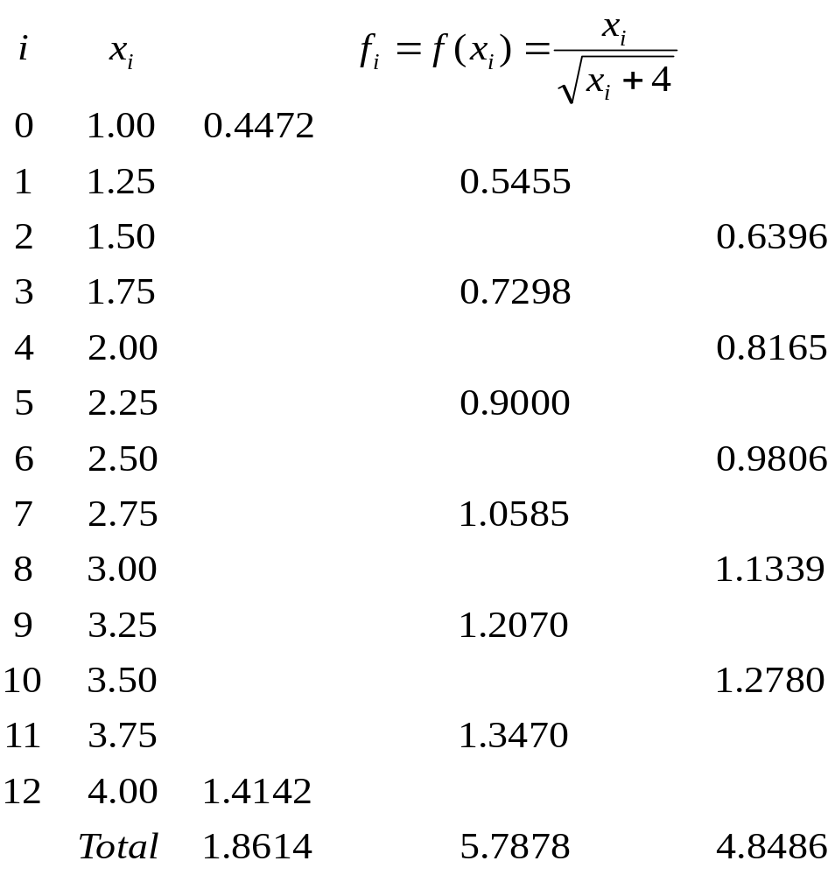
Example
prepared by Razana Alwee

Slide 36
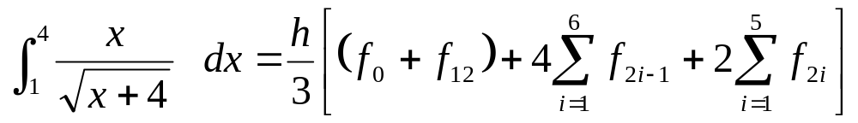
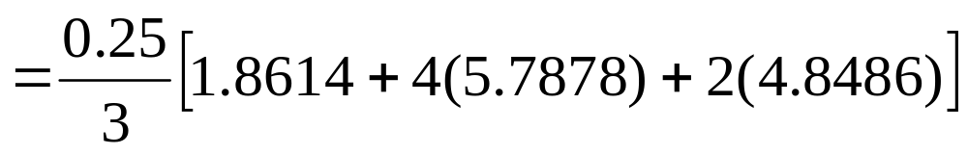
Example
prepared by Razana Alwee

Slide 37
Example
Approximate the following integrals using the Simpson’s 3/8 rule with h=0.25.
prepared by Razana Alwee

Slide 38
Example
For h=0.25, a=1 and b=4
prepared by Razana Alwee

Slide 39

Example
prepared by Razana Alwee

Slide 40


Example
prepared by Razana Alwee

Slide 41
Simpson’s Rule
Simpson’s 1/3 rule is usually the method of preference because it attains third-order accuracy with three points rather than the four points required for the 3/8 version.
prepared by Razana Alwee

Slide 42

Exercise
Approximate the following integral
using
a) The Simpson’s 1/3 rule
b) The Simpson’s 3/8 rule
with N=12.
prepared by Razana Alwee

Slide 43
Romberg Integration
Romberg integration uses the Trapezoidal rule to give preliminary approximations and then applies the Richardson extrapolation process to improve the approximations.
prepared by Razana Alwee

Slide 44


Romberg Integration
The first step in the Romberg process obtains the Trapezoidal rule approximations.
Start with 1 subinterval,
prepared by Razana Alwee

Slide 45



Romberg Integration
For N_{i} subintervals, N_{i}=2^{i-1} (eg. N₂=2, N₃=4, N₄=8)
or
i=2, 3, …
prepared by Razana Alwee

Slide 46


Romberg Integration
Example: for i=2, N₂=2²⁻¹=2
prepared by Razana Alwee

Slide 47




Romberg Integration
prepared by Razana Alwee

Slide 48


Romberg Integration
Example: for i=3, N₃=2³⁻¹=4
prepared by Razana Alwee

Slide 49




Romberg Integration
prepared by Razana Alwee

Slide 50


Romberg Integration
For i=2, 3, …
prepared by Razana Alwee

Slide 51

Romberg Integration
Richardson’s improvement,
for i = 2, 3, …, N and j = 2, 3 …, i.
prepared by Razana Alwee

Slide 52




Romberg Integration
prepared by Razana Alwee

Slide 53

Romberg Table
Compute the Romberg table until |R_{i,j} - R_{i,j-1}|<ε
prepared by Razana Alwee

Slide 54
Example
Use Romberg integration to approximate
Compute the Romberg table until |R_{i,j} − R_{i,j-1}|<0.0005
prepared by Razana Alwee

Slide 55


Example
prepared by Razana Alwee

Slide 56


Example
prepared by Razana Alwee

Slide 57

Example
prepared by Razana Alwee

Slide 58


Example
prepared by Razana Alwee

Slide 59

Example
prepared by Razana Alwee

Slide 60

Example
prepared by Razana Alwee

Slide 61

Example
The solution is,
prepared by Razana Alwee

Slide 62

Example
The Romberg Table,
prepared by Razana Alwee

Slide 63


Exercise
Use Romberg integration to approximate:
(a) (b)
Compute the Romberg table until |R_{i,j} − R_{i,j-1}|<0.005
prepared by Razana Alwee

Slide 64

Exercise
Use the two point and three point Gaussian Quadrature to approximate:
(a) (b)
Do calculations in 4 decimal points.
prepared by Razana Alwee

